Slide 1
12 Drought-Tolerant Plants to Make Your Yard Feel Lush, But Lean!
JEFF ANDERSON, M.S.
AGRICULTURAL EXTENSION AGENT
Doña Ana County Cooperative Extension Service

Slide 2
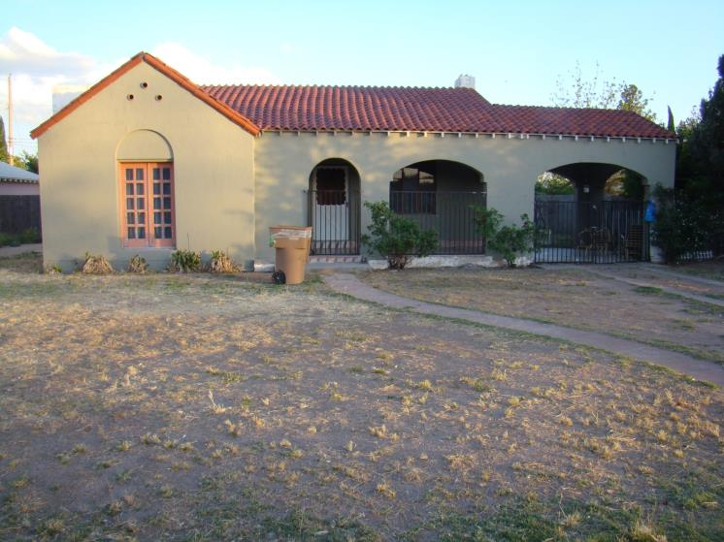
March 2010

Slide 3
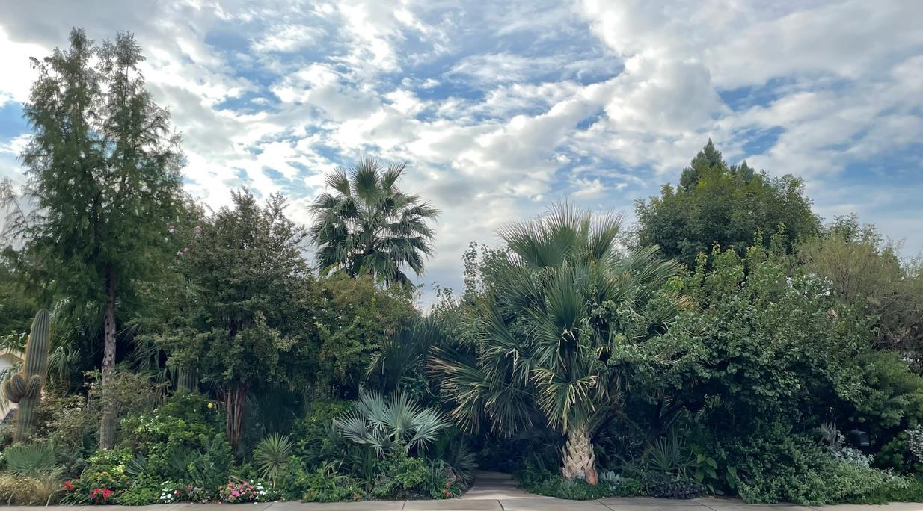
13-year-old garden started from barren ground in Las Cruces, New Mexico 2023

Slide 4
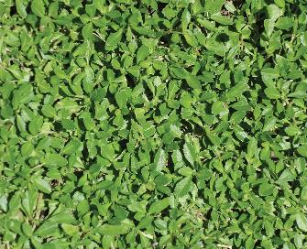
Ground Cover
Name: Phyla (or Lippia) nodiflora L. “Kurapia”
Common Name: Kurapia
Plant Type: Evergreen Perennial
Growth Habit: Prostate, Sterile, Non-Invasive
Planting Season: Best in March to September
Flowers: Small, White, May to November
Height: Low growing, less than 1”- 2” high in full sun
Width: Spreading to 6 feet
Exposure: Sun to Part Shade
Drought Tolerant: ETo 20% by drip irrigation and ETo 40% by sprinkler irrigation
pH Tolerant: pH 4 to 9
Salinity: Up to EC 7ds/m
Temperature: 15F -120F
USDA Hardiness Zones: 7b-11
https://www.valleysod.com/
ETo represents the evapotranspiration rate from a reference surface, not short of water. A large uniform grass field is considered worldwide as the reference surface. The reference crop completely covers the soil, is kept short, well watered and is actively growing under optimal agronomic conditions.

Slide 5
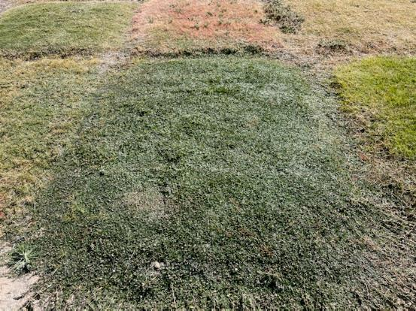
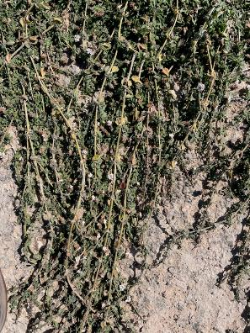
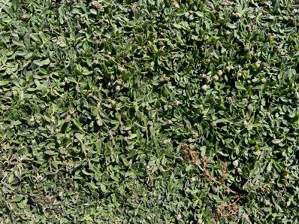
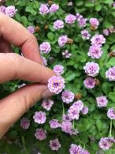
Kurapia
A semi-evergreen groundcover that requires minimal maintenance and 75% less water than traditional turf grasses. Kurapia provides great erosion control and weed abatement and is excellent on flat ground or slopes.

Slide 6
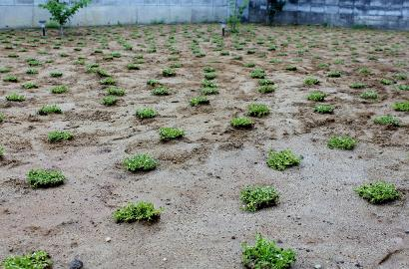
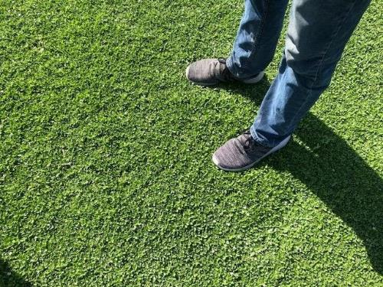
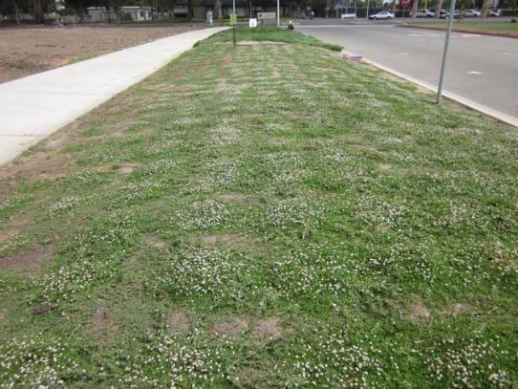
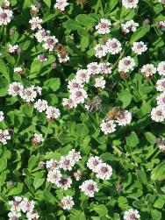

Slide 7
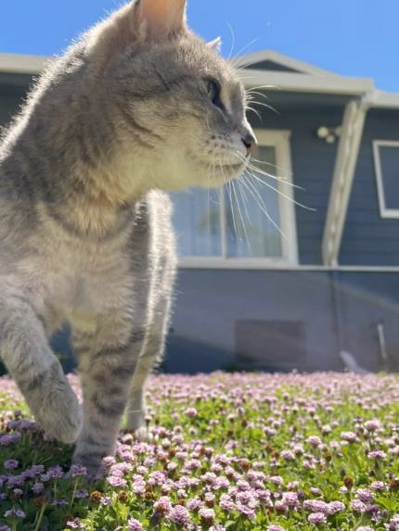
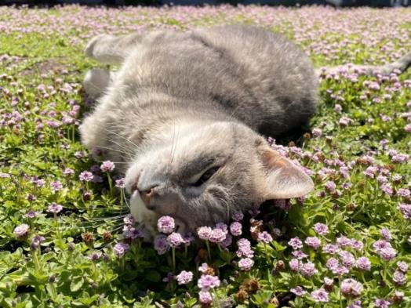
Lorraine B.
Kurapia Pink and Kurapia New White both grow deep roots, up to 9′ or longer, making it perfect for anchoring to hillsides and being drought tolerant
Lorraine B.
info@kurapia.com

Slide 8
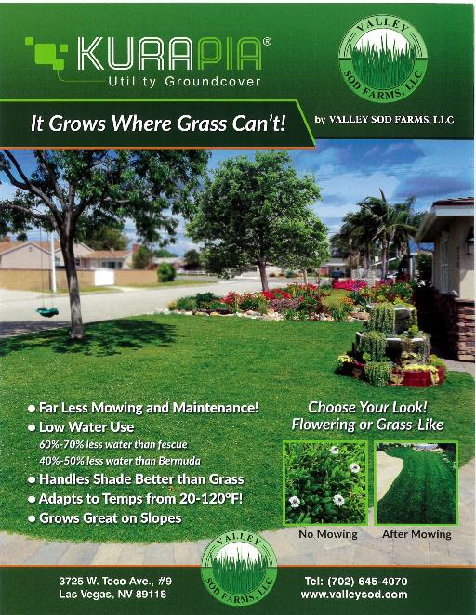
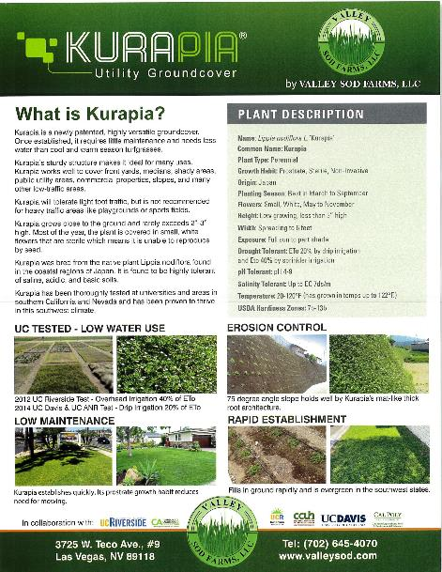

Slide 9
Accent Plants

Slide 10
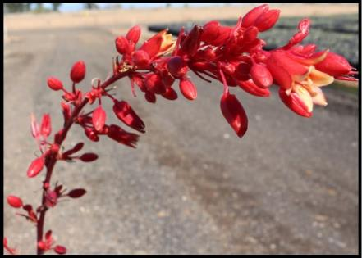
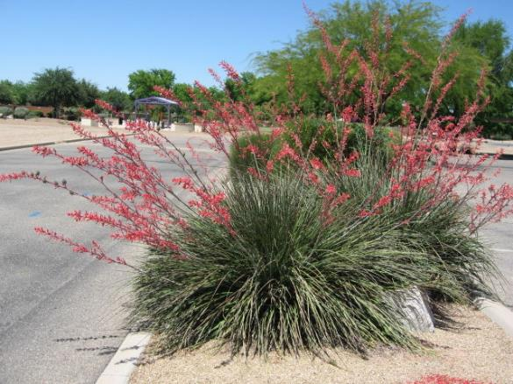
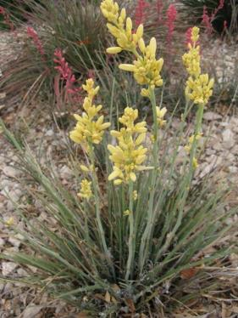
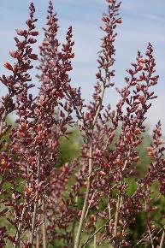
Hesperaloe parviflora ‘Red Yucca’
Cultivars: Sandia Glow, Brake Lights, Desert Dusk, Perpa, Desert Sun, Desert Flamenco, etc.

Slide 11
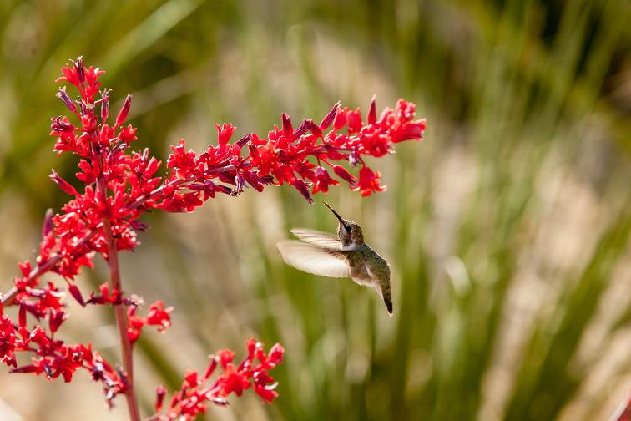
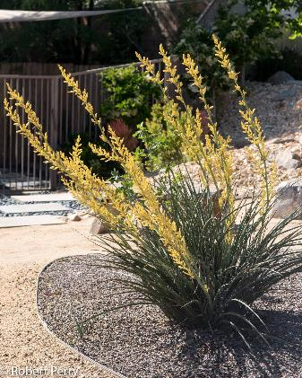
Creator: Mark Davidson
Copyright: Mark Davidson-2013
Cultivars: Sandia Glow, Brake Lights, Desert Dusk, Perpa, Desert Sun, Desert Flamenco, etc.
Hesperaloe parviflora ‘Red Yucca’

Slide 12
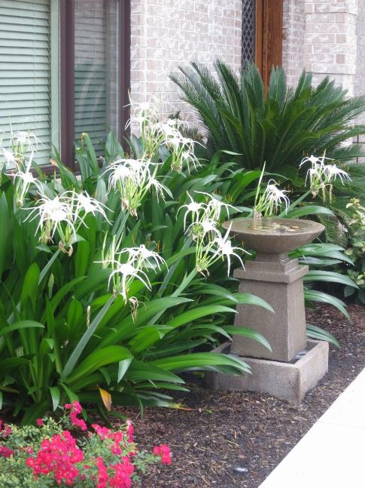
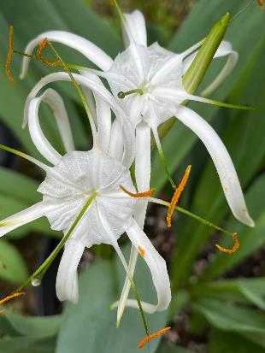
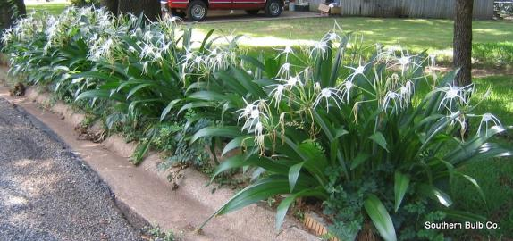
Hymenocallis ‘Tropical Giant’

Slide 13
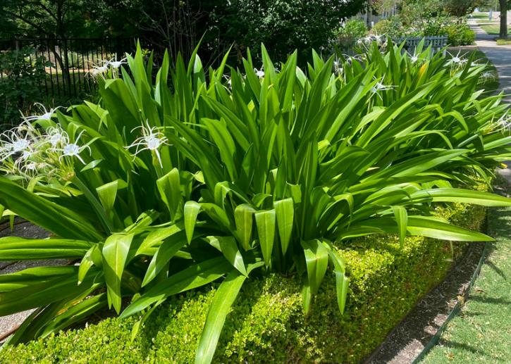
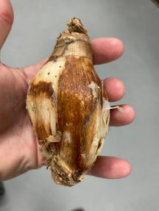
Hymenocallis sp. ‘Tropical Giant’
https://www.terraceiafarms.com/product/00/1PR030/Hymenocallis-Tropical-Giant
https://www.southernbulbs.com/hymenocallis-tropical-giant/

Slide 14
Shrubs

Slide 15
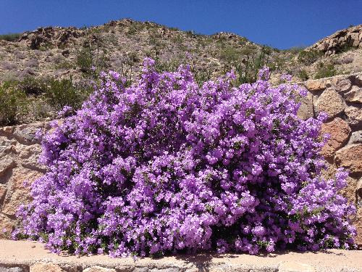
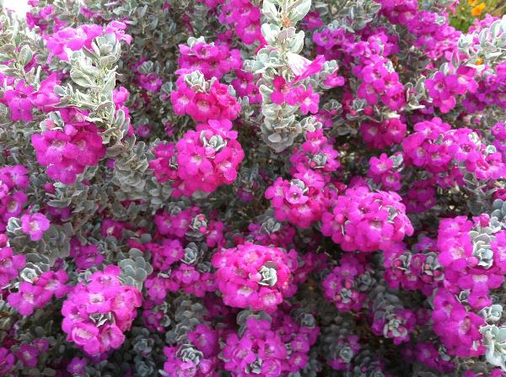
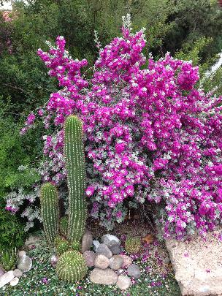
Leucophyllum ‘Cimmaron’
Texas Ranger
Leucophyllum ‘Convent’
Texas Sage

Slide 16
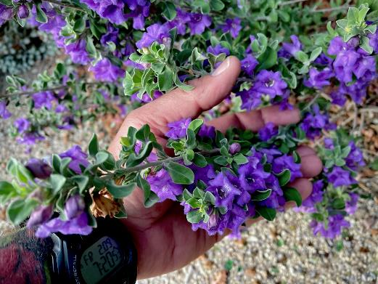
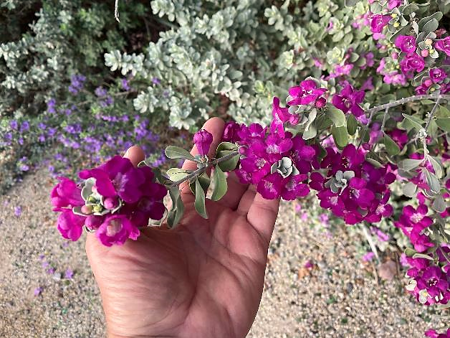
Leucophyllum ‘Ann Richards’
Leucophyllum ‘June Levy’
Cultivars: Green Cloud, White Cloud, Cimmaron, Houdini, Lynn’s Legacy, Microburst, etc.

Slide 17
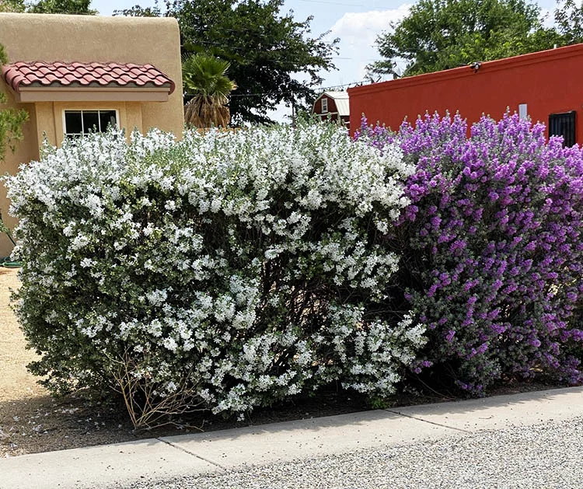
Leucophyllum
‘White Cloud’
&
‘Green Cloud’
https://guzmansgreenhouse.com
https://guzmansgreenhouse.com

Slide 18
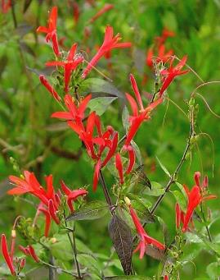
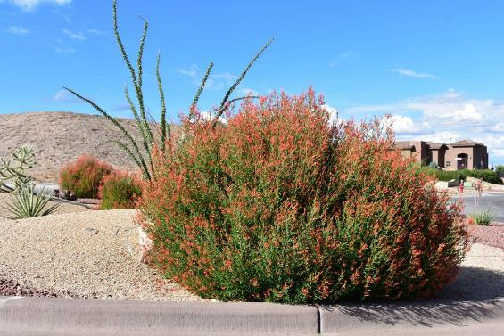
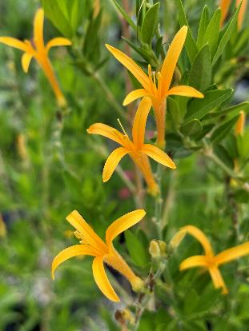
Photo: David Cristiani
Anisacanthus quadrifidus var. wrightii
‘Mexican Flame Bush’
var. ‘Pumpkin’

Slide 19
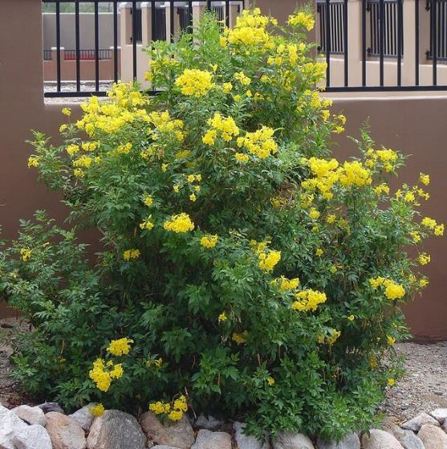
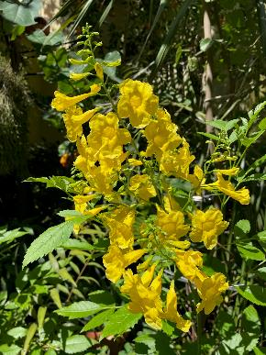
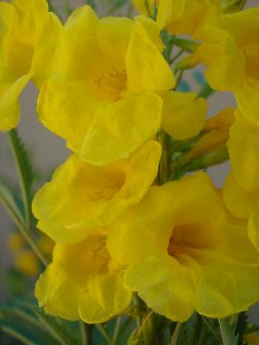
Tecoma stans ‘Yellow Bells/Esperanza’

Slide 20
Small Trees

Slide 21
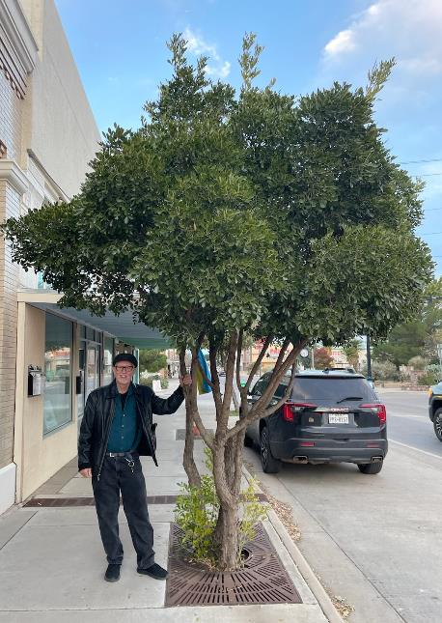
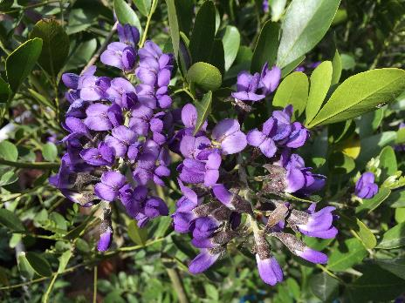
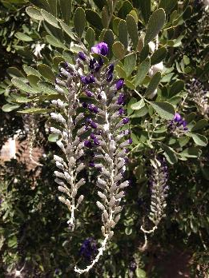
Texas Mountain Laurel
TML in Alpine, TX as a Street Tree

Slide 22
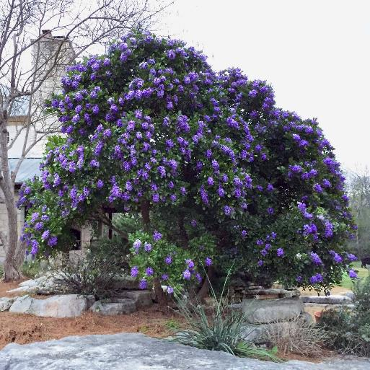
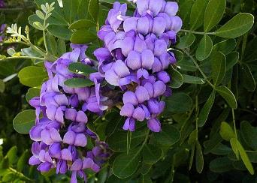
Dermatophyllum secundiflorum
‘Texas Mountain Laurel’

Slide 23
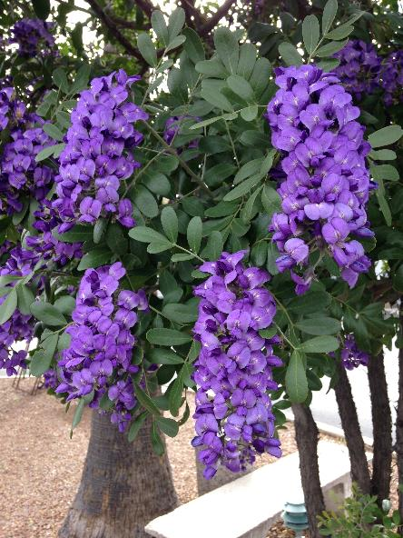
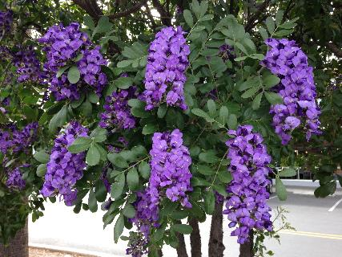

Slide 24
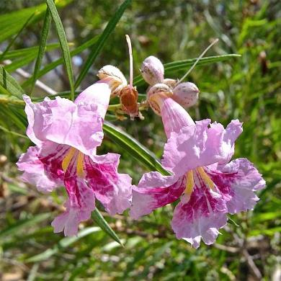
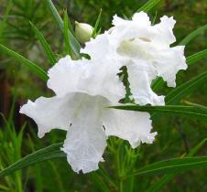
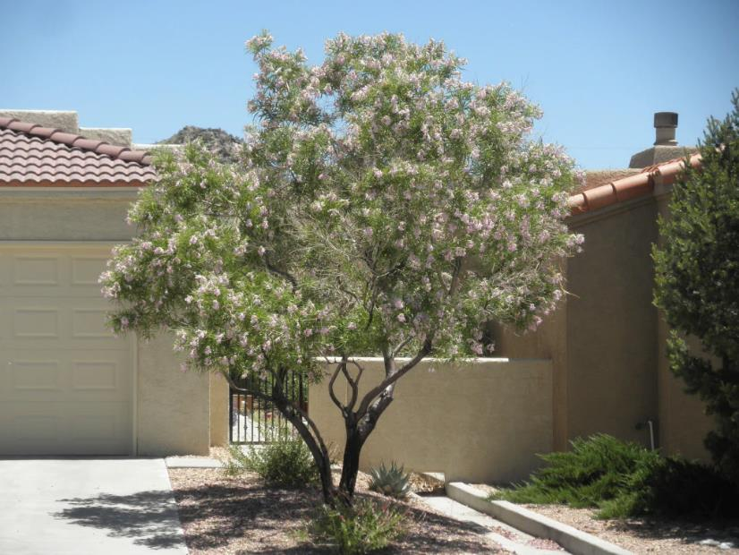
‘Bubba Jones’
HOPE DESERT WILLOW
Desert Willow
Chilopsis linearis

Slide 25
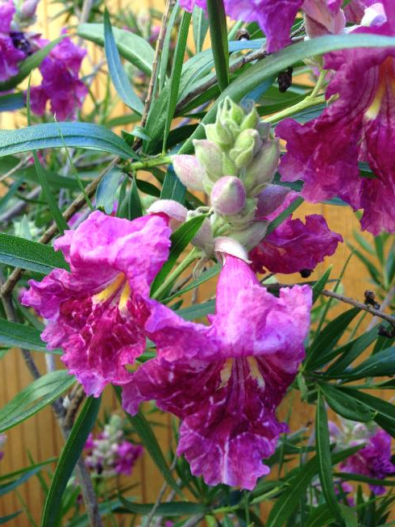
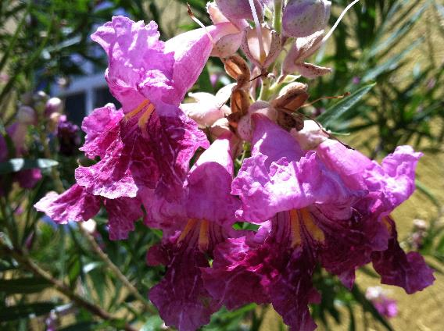
Desert Willow ‘Bubba’

Slide 26
Shade Trees

Slide 27
Pistacia X ‘Red Push’
(Pistacia atlantica and P. integerrima)

Slide 28
Pistacia ‘Red Push’

Slide 29
Texas Honey Mesquite
Photo’s courtesy of: John White
Photo’s courtesy of: John White

Slide 30
‘Texas Honey Mesquite’ Prosopis glandulosa var. glandulosa

Slide 31
Texas Honey Mesquite

Slide 32
Spartan Juniper
Juniperus chinensis 'Spartan'

Slide 33
Juniperus scopulorum
‘Rocky Mountain Juniper’

Slide 34
Juniperus deppeana
(blue form pachyphylla)
‘Alligator Juniper’

Slide 35
Ground Covers
Kurapia (702.645.4070)
Bermuda Grass
Buffalo Grass/Blue Gramma
Ruschia nana/minor (702.245.3978)
Ice Plant
Dalea greggii
Teucrium chamaedrys ‘Germander’
Zephyranthes candida
Shrubs
Texas Ranger/Sage
Buddleja marrubifolia
Turpentine Bush
Tecoma stans
Apache Plume
Aloysia wrightii
Cordia parvifolia
Teucrium fruiticans
Sabal minor
Rosemary
Bear Grass
Anisacanthus quadrifidus var. wrightii
‘Mexican Firecracker Bush’
Trees
‘Red Push’ Pistache hyb.
Mesquite
Spartan juniper
Alligator Juniper
Rocky Mountain Juniper
‘Joan Leonetti’ Live Oak
Cedar Elm Ulmus crassifolia
Mastic Gum Pistacia lentiscus
Blue Palo Verde
Mexican Blue Oak
Eucalyptus microtheca
Eucalyptus neglecta
California Fan Palm
Mexican Sabal Palm
‘Yellowhorn’ Xanthoceras sorbifolium
Accent Plants
Hesperaloe ‘Red Yucca’
Yucca gloriosa (var. variegate)
Hymenocallis ‘Spider Lilies’
Crinum Lilies
Salvia sp.
Lantana sp. ‘New Gold’, ‘Gold Mound’
Muhlenbergia capillaris ‘Regal Mist’
Hesperaloe sp.
Lomandra sp. ‘Australian Mat Rush’
Cistus sp.
Small Trees
Desert Willow ‘Bubba’
Scrub Oak
Golden Ball Lead Tree
Arroyo Sweetwood
Yucca rostrata
Vitex ‘Shoal Creek’
Mediterranean Fan Palm
Crape Myrtle ‘Natchez’ or ‘Muskogee’
Hibiscus syriacus
Arizona Rosewood
Texas Mountain Laurel
Vachellia constricta ‘White Thorn Acacia’

Slide 36
Contact Information: Jeff Anderson Doña Ana County Cooperative Extension Service 1170 N. Solano Drive, Suite M Las Cruces, New Mexico 88001
Office: (575) 525-6649
Fax: (575) 525-6702 donaanaextension.nmsu.edu

